Slide 1

Java PrintStream class
A PrintStream adds functionality to another output stream, namely the ability to print representations of various data values conveniently.
Unlike other output streams, a PrintStream never throws an IOException; instead, exceptional situations merely set an internal flag that can be tested via the checkError method.
Optionally, a PrintStream can be created so as to flush automatically; this means that the flush method is automatically invoked after a byte array is written, one of the println methods is invoked, or a newline character or byte ('\n') is written.
The Java PrintStream class (java.io.PrintStream) enables you to write formatted data to an underlying OutputStream. The PrintStream class can format primitive types like int, long etc. formatted as text, rather than as their byte values. That is why it is called a PrintStream, because it formats the primitive values as text - like they would look when printed to the screen (or printed to paper).
The Java PrintStream class contains the powerful format() and printf() methods (they do exactly the same, but the name "printf" is more familiar to C-programmers). These methods allow you to mix text and data in very advanced ways, using a formatting string.
PrintStream
OutputStream
PrintStream
Java Application
Write
Write

Slide 2
Java PrintStream class
OutputStream
PrintStream
FilterOutputStream

Slide 3
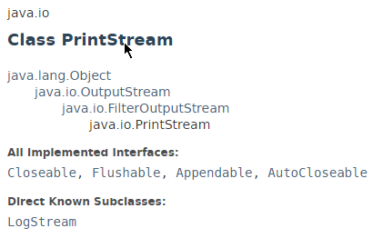
Java PrintStream class

Slide 4
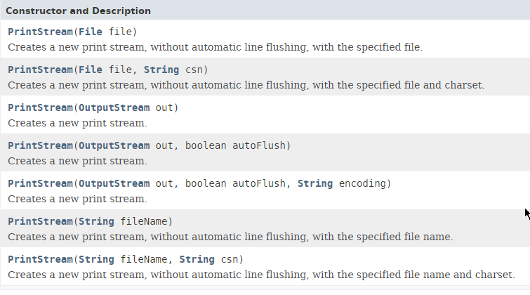
Java PrintStream class

Slide 5
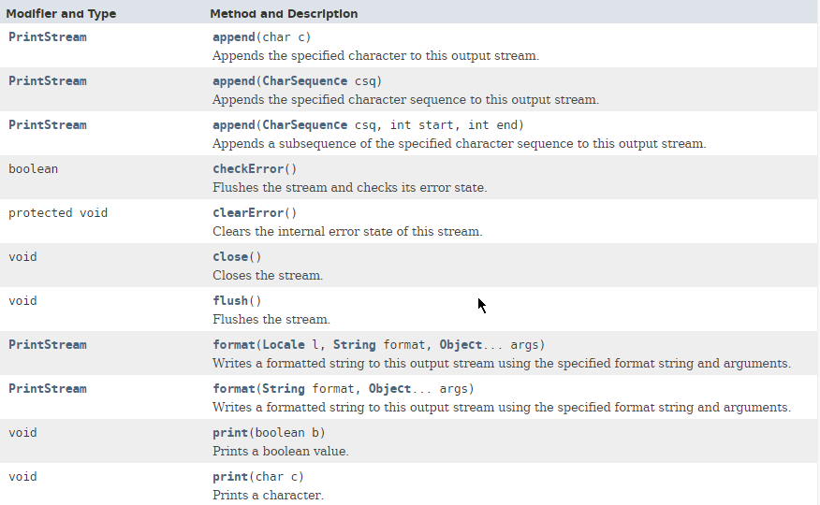
Java PrintStream class

Slide 6
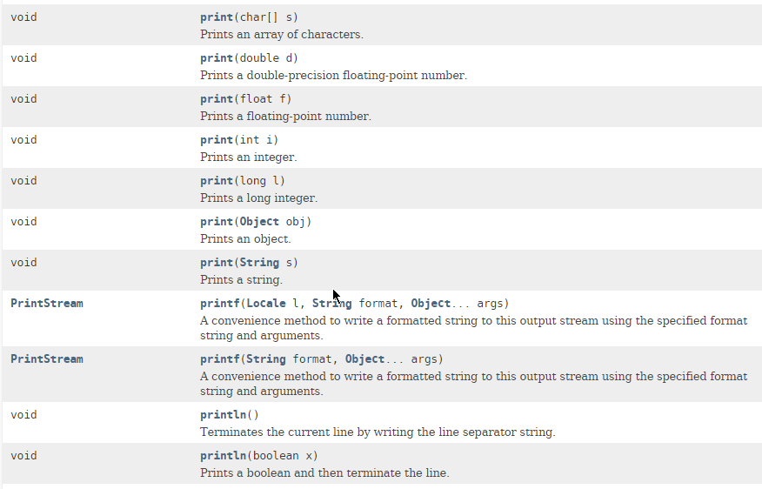
Java PrintStream class

Slide 7
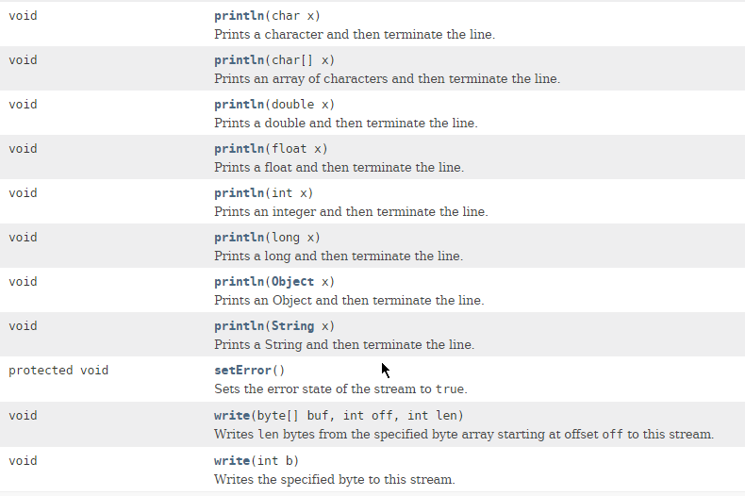
Java PrintStream class

Slide 8
Java PrintStream class
https://docs.oracle.com/javase/8/docs/api/index.html?java/io/PrintStream.html

